Slide 1


Thomas’ Calculus: Early Transcendentals
Fifteenth Edition
Chapter 16
Integrals and Vector Fields
Copyright © 2023, 2018, 2014 Pearson Education, Inc. All Rights Reserved
Notes:
If this PowerPoint presentation contains mathematical equations, you may need to check that your computer has the following installed:
1) MathType Plugin
2) Math Player (free versions available)
3) NVDA Reader (free versions available)

Slide 2
Section 16.6 Surface Integrals

Slide 3
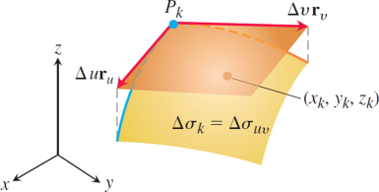
Surface Integrals (1 of 14)
The area of the patch
is approximated by the area
of the tangent parallelogram determined by the vectors
The point
lies on the surface
patch, beneath the parallelogram shown here.
Notes:
The parallelogram has vertices at delta u r sub u, P sub k, and delta v r sub v. The patch surface of delta sigma sub k = delta sigma sub start expression u v end expression is placed below the parallelogram. A point (x sub k, y sub k, z sub k) is marked on the surface.

Slide 4
Surface Integrals (2 of 14)
Depending on how we pick
in the kth
patch, we may get different values for this Riemann sum. Then we take the limit as the number of surface patches increases, their areas shrink to zero, and both
This limit, whenever it exists
independent of all choices made, defines the surface integral of G over the surface S as

Slide 5
Surface Integrals (3 of 14)

Slide 6
Surface Integrals (4 of 14)
Formulas for a Surface Integral of a Scalar Function
1. For a smooth surface S defined parametrically as
and a
continuous function
defined on S, the
surface integral of G over S is given by the double integral over R,

Slide 7
Surface Integrals (5 of 14)
2. For a surface S given implicitly by
where F is a continuously differentiable function, with S lying above its closed and bounded shadow region R in the coordinate plane beneath it, the surface integral of the continuous function G over S is given by the double integral over R,
where p is a unit vector normal to R and

Slide 8
Surface Integrals (6 of 14)
3. For a surface S given explicitly as the graph of
where f is a continuously differentiable
function over a region R in the x y-plane, the surface integral of the continuous function G over S is given by the double integral over R,

Slide 9
Surface Integrals (7 of 14)
Example: Integrate
over the cone
Solution: We have

Slide 10
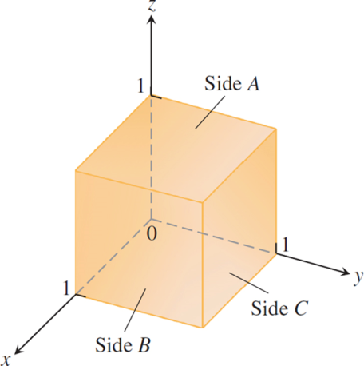
Surface Integrals (8 of 14)
The cube in the next Example.

Slide 11
Surface Integrals (9 of 14)
Example: Integrate
over the surface
of the cube cut from the first octant by the planes
x = 1, y = 1, and z = 1.
Solution: We integrate x y z over each of the six sides and add the results. Since x y z = 0 on the sides that lie in the coordinate planes, the integral over the surface of the cube reduces to

Slide 12
Surface Integrals (10 of 14)
Solution (continued):
Side A is the surface
over the square
region
in the x y-plane. For this
surface and region,

Slide 13
Surface Integrals (11 of 14)
Solution (concluded):
and
Symmetry tells us that the integrals of x y z over sides
B and C are also
Hence,

Slide 14
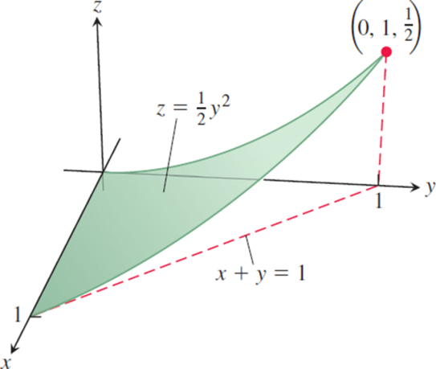
Surface Integrals (12 of 14)
The surface S in the next Example.
Notes:
The region extends between (0, 0, 0), (1, 0, 0), and (0, 1, 1 half). A dashed line extends from (1, 0, 0) to (0, 1, 0). A vertical dashed line extends from (0, 1, 1 half) to (0, 1, 0).

Slide 15
Surface Integrals (13 of 14)
Example: Evaluate
on the portion of
the cylinder
over the triangular region
in the x y-plane.
Solution: The function G on the surface S is given by
With
we evaluate the surface integral:

Slide 16
Surface Integrals (14 of 14)
Solution (concluded):
and

Slide 17
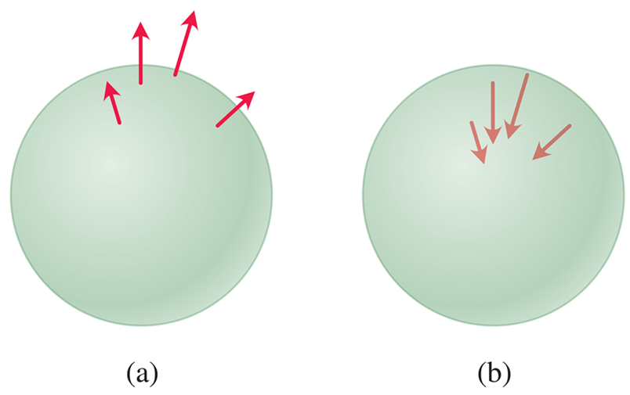
Orientation of a Surface (1 of 2)
An outward-pointing vector field (a) and an inward-pointing vector field (b) give the two possible orientations of a sphere.

Slide 18
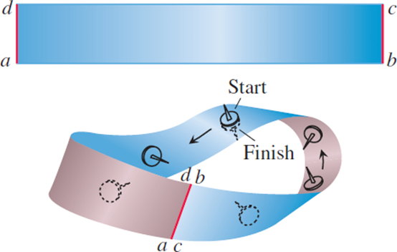
Orientation of a Surface (2 of 2)
To make a Möbius band, take a rectangular strip of paper a b c d, give the end b c a single twist, and paste the ends of the strip together to match a with c and b with d. The Möbius band is a nonorientable or one-sided surface.

Slide 19
Surface Integrals of Vector Fields
Definition: Let F be a vector field in three-dimensional space with continuous components defined over a smooth surface S having a chosen field of normal unit vectors n orienting S. Then the surface integral of F over S is
This integral is also called the flux of the vector field F across S.

Slide 20
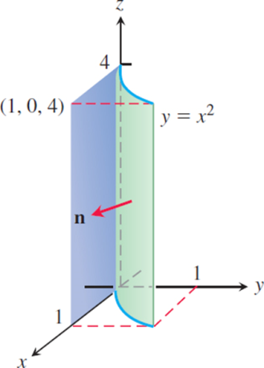
Computing a Surface Integral for a Parametrized Surface (1 of 4)
Finding the flux through the surface of a parabolic cylinder.

Slide 21
Computing a Surface Integral for a Parametrized Surface (2 of 4)
Example: Find the flux of
through
the parabolic cylinder
in the
direction n.
Solution: On the surface we have
and z = z, so we automatically have the parametrization
The cross
product of tangent vectors is

Slide 22
Computing a Surface Integral for a Parametrized Surface (3 of 4)
Solution (continued):
The unit normal vectors pointing outward from the surface as indicated in the previous Figure are
On the surface,
so the vector field there is
Thus,

Slide 23
Computing a Surface Integral for a Parametrized Surface (4 of 4)
Solution (concluded):
The flux of F outward through the surface is

Slide 24
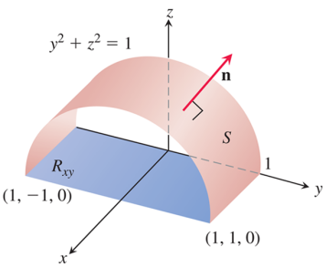
Computing a Surface Integral for a Level Surface (1 of 3)
Calculating the flux of a vector field outward through
the surface S. The area of the shadow region
Notes:
The curved surface for y squared + z squared = 1 has a vector n that rises perpendicularly on the surface. The rectangular plane R has vertices at (1, negative 1, 0), (1, 1, 0), (0, 1, 0), and (0, negative 1, 0).

Slide 25
Computing a Surface Integral for a Level Surface (2 of 3)
Example: Find the flux of
outward
through the surface S cut from the cylinder
by the planes x = 0 and x = 1.
Solution: The outward normal field on S may be
calculated from the gradient of
to be
With p = k, we also have

Slide 26
Computing a Surface Integral for a Level Surface (3 of 3)
Solution (concluded):
We can drop the absolute value bars because z = 0 on S.
The value of
on the surface is
The surface projects onto the shadow region
which is
the rectangle in the x y-plane. Therefore, the flux of F outward through S is

Slide 27
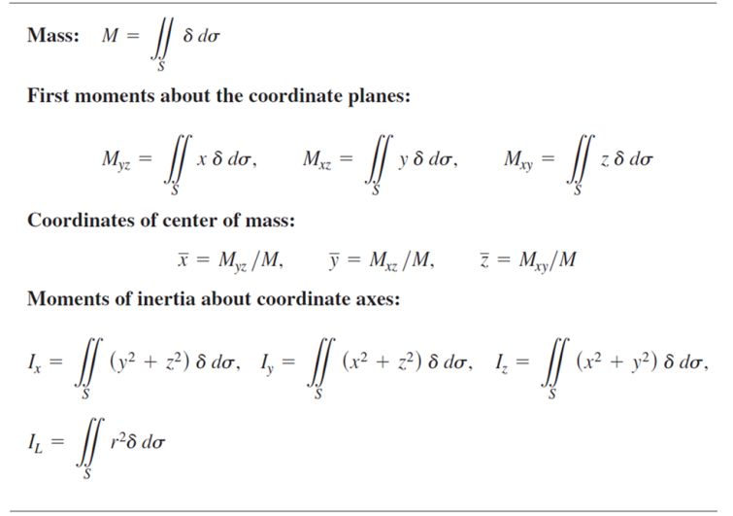
Moments and Masses of Thin Shells (1 of 4)
Table Mass and moment formulas for very thin shells
Notes:
Where delta = delta of left parenthesis x, y, z right parenthesis = density at left parenthesis x, y, z right parenthesis is mass per unit area. The formula for the first moments about the coordinate planes is M sub start expression y z end expression = the surface integration for x delta d sigma, M sub start expression x z end expression = the surface integration for y delta d sigma, M sub start expression x y end expression = the surface integration for z delta d sigma. The formula for the coordinates of center of mass is x bar = start fraction M sub start expression y z end expression over M end fraction, y bar = start fraction M sub start expression x z end expression over M end fraction, z bar = start fraction M sub start expression x y end expression over M end fraction. The formula for moments of inertia about coordinate axes is I sub x = the surface integration for left parenthesis y squared + z squared right parenthesis delta d sigma, I sub y = the surface integration for left parenthesis x squared + z squared right parenthesis delta d sigma, I sub z = the surface integration for left parenthesis x squared + y squared right parenthesis delta d sigma, I sub L = the surface integration for r squared delta d sigma. r of x, y, z = distance from point (x, y, z) to line L.

Slide 28
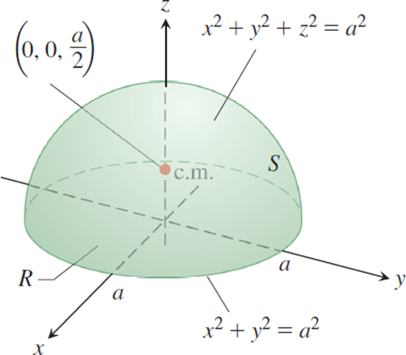
Moments and Masses of Thin Shells (2 of 4)
The center of mass of a thin hemispherical shell of constant density lies on the axis of symmetry halfway from the base to the top
Notes:
The center of mass is labeled at (0, 0, start fraction a over 2 end fraction). The base of hemisphere surface is circle for x squared + y squared = a squared.

Slide 29
Moments and Masses of Thin Shells (3 of 4)
Example: Find the center of mass of a thin hemispherical
shell of radius a and constant density
Solution: We model the shell with the hemisphere
The symmetry of the surface about the z-axis tells us that
It remains only to find
from the
formula
The mass of the shell is

Slide 30
Moments and Masses of Thin Shells (4 of 4)
Solution (concluded):
To evaluate the integral for
we take p = k and calculate
Then
The shell’s center of mass is the point

Slide 31
Section 16.7 Stokes’ Theorem

Slide 32
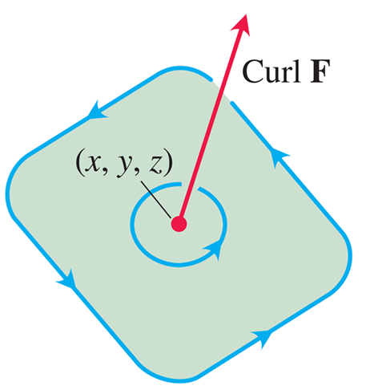
The Curl Vector Field (1 of 3)
The circulation vector at a point (x, y, z) in a plane in a three-dimensional fluid flow. Notice its right-hand relation to the rotating particles in the fluid.

Slide 33
The Curl Vector Field (2 of 3)
The symbol
is pronounced “del,” and we can use this
symbol to compute the curl of F with the formula
We often use this cross product notation to write the curl symbolically as “del cross F.”

Slide 34
The Curl Vector Field (3 of 3)
Example: Find the curl of
Solution: We use the determinant form for the cross product, which gives,

Slide 35
Stokes’ Theorem (1 of 13)
Theorem—Stokes’ Theorem
Let S be a piecewise smooth oriented surface having a
piecewise smooth boundary curve C. Let
be a vector field whose components have continuous first partial derivatives on an open region containing S. Then the circulation of F around C in the direction counterclockwise with respect to the surface’s unit normal vector n equals the
integral of the curl vector field
over S:

Slide 36
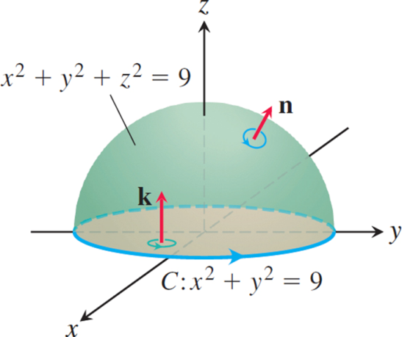
Stokes’ Theorem (2 of 13)
A hemisphere and a disk, each with boundary C.
Notes:
The hemisphere for x squared + y squared + z squared = 9 has a curve C, for x squared + y squared = 9, along the circular base. A vector k rises from the base of the hemisphere in upward direction, and another vector n from the top of the hemisphere points outside the surface.

Slide 37
Stokes’ Theorem (3 of 13)
Example: Evaluate the previous Example for the hemisphere
its bounding circle C:
and the field
Solution: The hemisphere looks much like the surface in with the bounding circle C in the x y-plane. We calculate the counterclockwise circulation around C (as viewed from above) using the parametrization

Slide 38
Stokes’ Theorem (4 of 13)
Solution (continued):
For the curl integral of F, we have

Slide 39
Stokes’ Theorem (5 of 13)
Solution (concluded):
and
The circulation around the circle equals the integral of the curl over the hemisphere, as it should from Stokes’ Theorem.

Slide 40
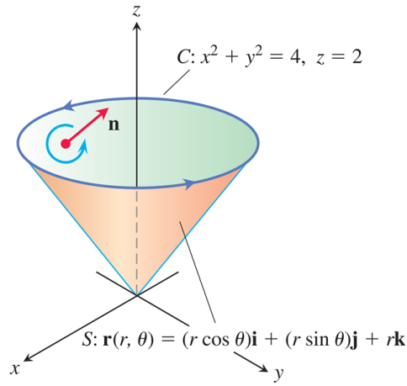
Stokes’ Theorem (6 of 13)
The curve C and cone S in the following Example.
Notes:
The cone for curved surface S, for r of r and theta = left parenthesis r cosine of theta right parenthesis i + left parenthesis r sine of theta right parenthesis j + r k, has a circular top. The circular top for C, x squared + y squared = 4, z = 2, moves in a counterclockwise direction. A vector n is pointing toward z axis from the circular surface.

Slide 41
Stokes’ Theorem (7 of 13)
Example: Find the circulation of the field
around the curve C in which the plane z = 2 meets the cone
counterclockwise as viewed from above.
Solution: Stokes’ Theorem enables us to find the circulation by integrating over the surface of the cone.
We parametrize the cone as
We then have

Slide 42
Stokes’ Theorem (8 of 13)
Solution (continued):
Accordingly,

Slide 43
Stokes’ Theorem (9 of 13)
Solution (concluded):
and the circulation is

Slide 44
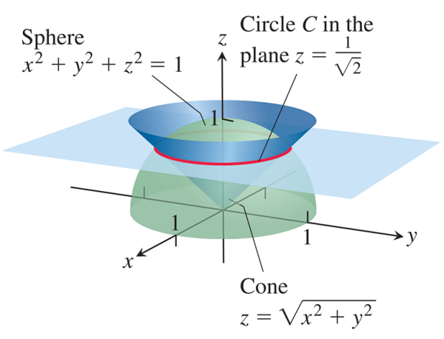
Stokes’ Theorem (10 of 13)
Circulation curve C in the next Example.
Notes:
The hemisphere is for x squared + y squared + z squared = 1. The circle is for z = start fraction 1 over radical 2 end fraction. The cone is for z = the square root of start expression x squared + y squared end expression. The hemisphere, circle, and the cone overlap each other.

Slide 45
Stokes’ Theorem (11 of 13)
Example: Calculate the circulation of the vector field
along the curve of intersection of the sphere
with the cone
traversed in the counterclockwise direction around the z-axis when viewed from above.

Slide 46
Stokes’ Theorem (12 of 13)
Solution: The sphere and cone intersect when
We apply Stokes’ Theorem to the curve of intersection
considered as the boundary of the enclosed disk in
the plane
The normal vector to the surface is then
n = k. We calculate the curl vector as

Slide 47
Stokes’ Theorem (13 of 13)
Solution (concluded):
so that
The circulation around the
disk is

Slide 48
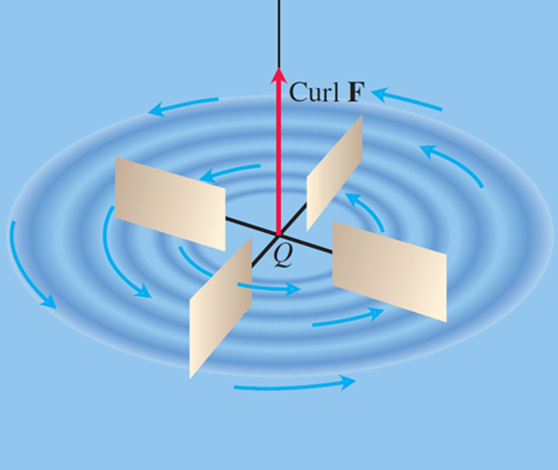
Paddle Wheel Interpretation of Nabla Times F (1 of 8)
A small paddle wheel in a fluid spins fastest at point Q when its axle points in the direction of curl F.

Slide 49
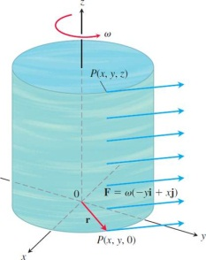
Paddle Wheel Interpretation of Nabla Times F (2 of 8)
A steady rotational flow parallel to the x y-plane, with
constant angular velocity
in the positive
(counter-clockwise) direction.
Notes:
The cylinder rotates at a flow for F = omega left parenthesis negative y i + x j right parenthesis that is parallel to the x y plane with an angular velocity omega in a counterclockwise direction. A point, P of x, y, z is marked on the top of the cylindrical surface. A vector r from the origin on the bottom surface of the cylinder is pointing at a point P of x, y, 0.

Slide 50
Paddle Wheel Interpretation of Nabla Times F (3 of 8)
Example: A fluid of constant density rotates around
the z-axis with velocity
where
is a positive constant called the angular velocity of the
rotation. Find
and relate it to the circulation density.
Solution: With
we find the curl

Slide 51
Paddle Wheel Interpretation of Nabla Times F (4 of 8)
Solution (concluded):
and therefore
By Stokes’ Theorem, the
circulation of F around a circle C of radius ρ bounding a
disk S in a plane normal to
say the x y-plane, is
Solving this last equation for
we see that
when u = k.

Slide 52
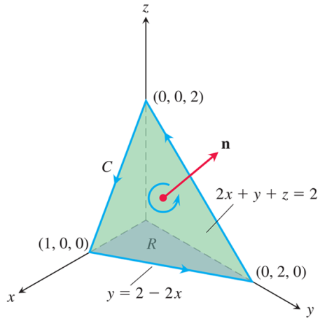
Paddle Wheel Interpretation of Nabla Times F (5 of 8)
The planar surface in the following Example.
Notes:
The triangle for 2 x + y + z = 2 with vertices at (1, 0, 0), (0, 2, 0), and (0, 0, 2). The vector from the z axis to the x axis is C. The vector from the x axis to the y axis is y = 2 minus 2 x. A vector n is pointing outside from the triangular surface, which rotates in a counterclockwise direction.

Slide 53
Paddle Wheel Interpretation of Nabla Times F (6 of 8)
Example: Use Stokes’ Theorem to evaluate
if
and C is the boundary of the
portion of the plane
in the first octant,
traversed counterclockwise as viewed from above.
Solution: The plane is the level surface
of the function
The unit
normal vector

Slide 54
Paddle Wheel Interpretation of Nabla Times F (7 of 8)
Solution (continued):
is consistent with the counterclockwise motion around C. To apply Stokes’ Theorem, we find
On the plane, z equals
and

Slide 55
Paddle Wheel Interpretation of Nabla Times F (8 of 8)
Solution (concluded):
The surface area differential is
The circulation is

Slide 56
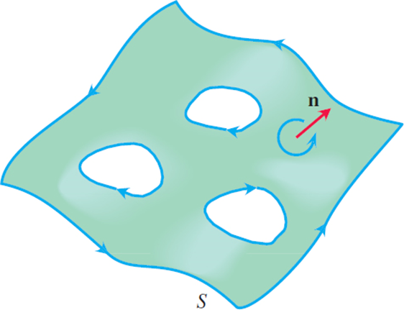
Stokes’ Theorem for Surfaces with Holes
Stokes’ Theorem also holds for oriented surfaces with holes. Consistent with the orientation of S, the outer curve is traversed counterclockwise around n and the inner curves surrounding the holes are traversed clockwise.

Slide 57
An Important Identity

Slide 58
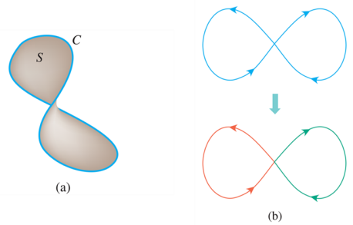
Conservative Fields and Stokes’ Theorem (1 of 2)
(a) In a simply connected open region in space, a simple closed curve C is the boundary of a smooth surface S.
(b) Smooth curves that cross themselves can be divided into loops to which Stokes’ Theorem applies.

Slide 59
Conservative Fields and Stokes’ Theorem (2 of 2)
Theorem—Curl F = 0 Related to the Closed-Loop Property
If
at every point of a simply connected
open region D in space, then on any piecewise-smooth closed path C in D,

Slide 60
Section 16.8 The Divergence Theorem and a Unified Theory

Slide 61
Divergence in Three Dimensions (1 of 5)
The divergence of a vector field
is the scalar function
The symbol “div F” is read as “divergence of
F” or “div F.” The notation
is read “del dot F.”

Slide 62
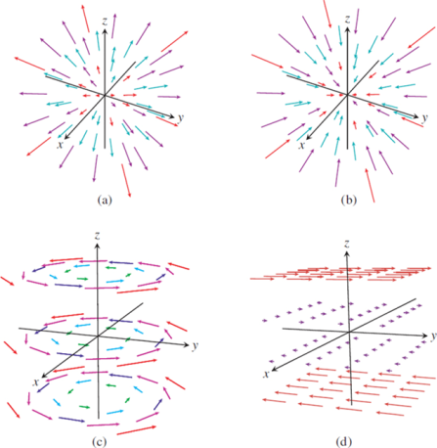
Divergence in Three Dimensions (2 of 5)
Velocity fields of a gas flowing in space.
Notes:
The first illustration, a, displays the velocity field that is away from the origin and with an increasing magnitude. The second illustration, b, displays the velocity field toward the origin and with a decreasing magnitude. The third illustration, c, displays the velocity field in three circular layers moving in counterclockwise direction around the z axis. The fourth illustration, d, displays the velocity field in three layers, from left to right above the x y plane and right to left below the x y plane.

Slide 63
Divergence in Three Dimensions (3 of 5)
Example: The following vector fields represent the velocity of a gas flowing in space. Find the divergence of each vector field and interpret its physical meaning. Displays the vector fields.
(a) Expansion:
(b) Compression:
(c) Rotation about the z-axis:
(d) Shearing along parallel horizontal planes:

Slide 64
Divergence in Three Dimensions (4 of 5)
Solution:
(a)
The gas is
undergoing constant uniform expansion at all points.
(b)
The gas is
undergoing constant uniform compression at all points.

Slide 65
Divergence in Three Dimensions (5 of 5)
Solution (concluded):
(c)
The gas is neither
expanding nor compressing at any point.
(d)
Again, the divergence is zero
at all points in the domain of the velocity field, so the gas is neither expanding nor compressing at any point.

Slide 66
Divergence Theorem (1 of 6)
Theorem—Divergence Theorem
Let F be a vector field whose components have continuous first partial derivatives, and let S be a piecewise smooth oriented closed surface. The flux of F across S in the direction of the surface’s outward unit normal field n equals the triple integral
of the divergence
over the region D enclosed
by the surface:

Slide 67
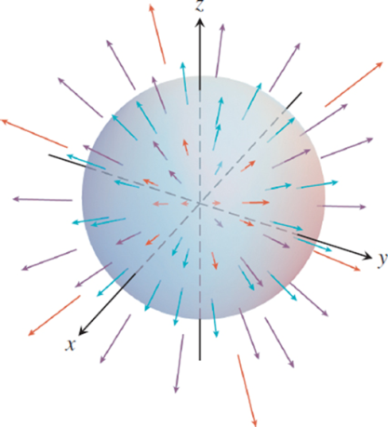
Divergence Theorem (2 of 6)
A uniformly expanding vector field and a sphere.

Slide 68
Divergence Theorem (3 of 6)
Example: Evaluate both sides of the Equation in the Divergence Theorem for the expanding vector field
F = x i + y j + z k over the sphere
Solution: The outer unit normal to S, calculated
from the gradient of
It follows that

Slide 69
Divergence Theorem (4 of 6)
Solution (concluded):
Therefore, the outward flux is
For the right-hand side of the Equation in the Divergence Theorem , the divergence of F is
so we obtain the divergence integral,

Slide 70
Divergence Theorem (5 of 6)
Corollary: The outward flux across a piecewise smooth oriented closed surface S is zero for any vector field F having zero divergence at every point of the region enclosed by the surface.

Slide 71
Divergence Theorem (6 of 6)
Example: Find the flux of F = x y i + y z j + x z k outward through the surface of the cube cut from the first octant by the planes x = 1, y = 1, and z = 1.
Solution: Instead of calculating the flux as a sum of six separate integrals, one for each face of the cube, we can calculate the flux by integrating the divergence
over the cube’s interior:

Slide 72
Divergence and the Curl
Theorem: If F = M i + N j + P k is a vector field with continuous second partial derivatives, then

Slide 73
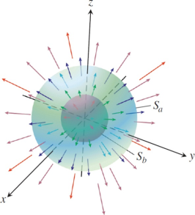
Divergence Theorem for Other Regions (1 of 5)
Two concentric spheres in an expanding vector field.
The outer sphere
surrounds the inner sphere

Slide 74
Divergence Theorem for Other Regions (2 of 5)
Example: Find the net outward flux of the field
across the boundary of the region D:
Solution: The flux can be calculated by integrating
over D. Note that
in D. We have

Slide 75
Divergence Theorem for Other Regions (3 of 5)
Solution (continued):
and
Similarly,
Hence,

Slide 76
Divergence Theorem for Other Regions (4 of 5)
Solution (continued):
So the net outward flux of F across the boundary of D is zero by the corollary to the Divergence Theorem. The flux of F across a sphere centered at the origin is independent of the radius of the sphere.
To find it, we evaluate the flux integral directly for an
arbitrary sphere
The outward unit normal on the
sphere of radius a is

Slide 77
Divergence Theorem for Other Regions (5 of 5)
Solution (concluded):
Hence, on the sphere,
and
The outward flux of F across any sphere centered at the
origin is
This result does not contradict the Divergence
Theorem because F is not continuous at the origin.

Slide 78
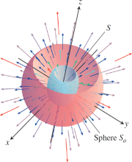
Gauss’s Law: One of the Four Great Laws of Electromagnetic Theory
A sphere
surrounding another surface S. The
of the surfaces are removed for visualization.

Slide 79
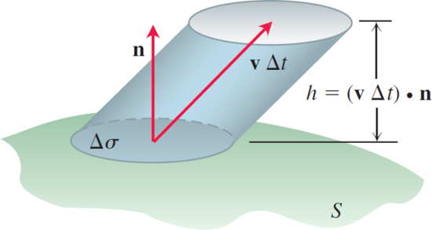
Continuity Equation of Hydrodynamics
The fluid that flows upward through the patch
in a short time
fills a “cylinder” whose volume is
approximately

Slide 80
Unifying the Integral Theorems (1 of 3)
Green’s Theorem and Its Generalization to Three Dimensions
Tangential form of Green’s Theorem:
Stokes’ Theorem:

Slide 81
Unifying the Integral Theorems (2 of 3)
Normal form of Green’s Theorem:
Divergence Theorem:

Slide 82
Unifying the Integral Theorems (3 of 3)
A Unifying Fundamental Theorem of Vector Integral Calculus
The integral of a differential operator acting on a field over a region equals the sum of the field components appropriate to the operator over the boundary of the region.

Slide 83

Copyright
This work is protected by United States copyright laws and is provided solely for the use of instructors in teaching their courses and assessing student learning. Dissemination or sale of any part of this work (including on the World Wide Web) will destroy the integrity of the work and is not permitted. The work and materials from it should never be made available to students except by instructors using the accompanying text in their classes. All recipients of this work are expected to abide by these restrictions and to honor the intended pedagogical purposes and the needs of other instructors who rely on these materials.

